Slide 1
Musiplectics Computational Assessment of the Complexity of Music Scores
Ethan Holder
Advisor: Eli Tilevich (CS)
Committee: Amy Gillick (Music) and R. Ben Knapp (ICAT)

Slide 2
Musiplectics
Music + Plectics (Greek for the study of complexity)
A systematic and objective approach to computational assessment of the complexity of a music score for any instrument.

Slide 3
Contents
Insights
Approach
Example
Proof of Concept
Musiplectics in Action
Future Work
Thesis Contributions

Slide 4

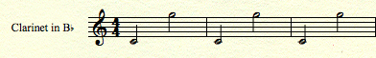
Insights
Musicians are a contentious and cantankerous bunch (i.e. two musicians, three opinions).
But, all can agree different notes pose different difficulties on wind instruments.
However, they may disagree on the magnitude of the differences.
[1]
?
2 3 4
1 2 1
Notes:
Depends on proficiency and opinions
On 1-10 scale

Slide 5
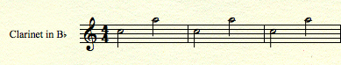
Insights
The same disparity of different difficulties can be observed with intervals.
?
2 3 4
Notes:
Hard to quantify, hard to aggregate
Simple but powerful
need a way to leverage

Slide 6
Insights
Simple ideas, but hard to quantify.
Pieces of music are too big for one person to analyze.
What effects do articulations, dynamics, and tempo have on the disparity?

Slide 7
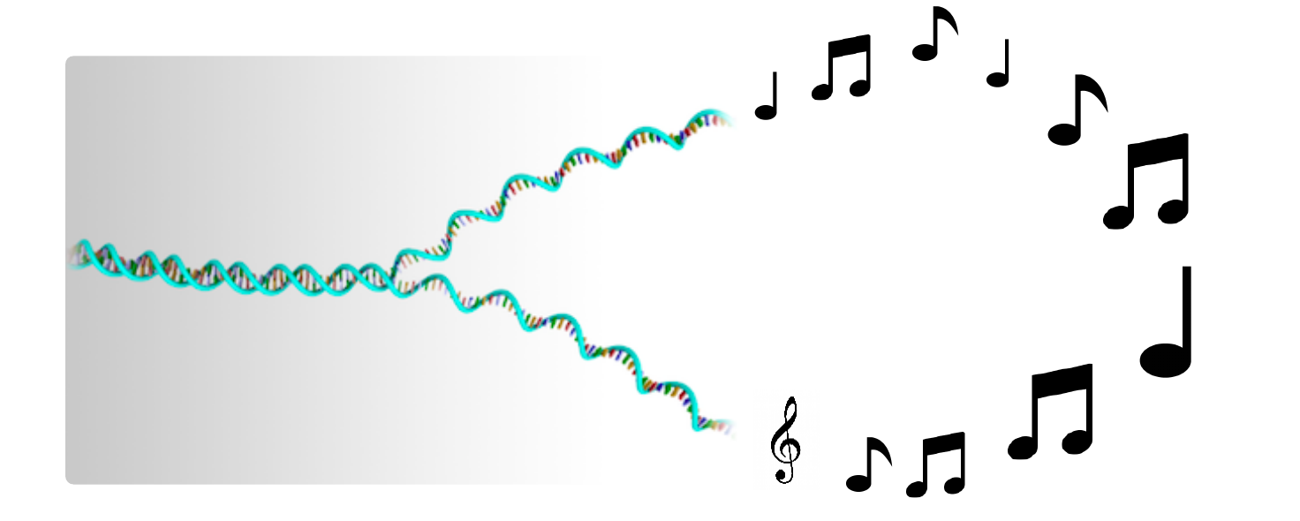
Insights
Computing offers us the capability to build upon these insights by eliminating the cognitive load required to assess the difficulty of realistic musical pieces.
We can “decipher the music genome” through computing.
[2]
Notes:
Mention bioinformatics

Slide 8
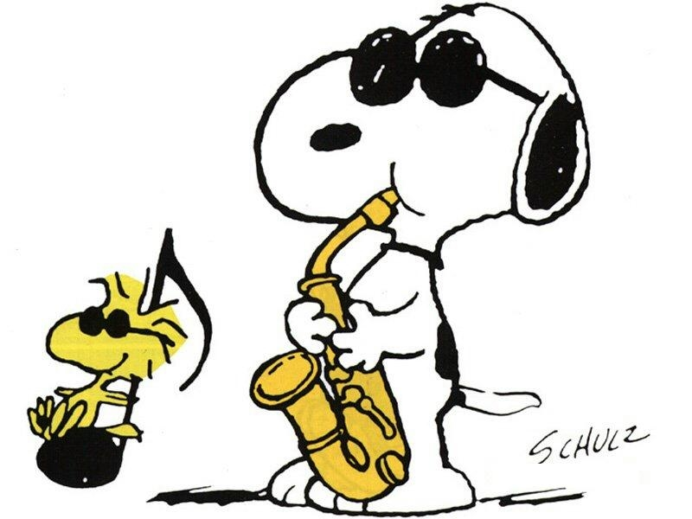
Insights
Educators, performers, professionals, composers, publishers, students, and more can leverage this technology to simplify their work.
[3]
Notes:
That’s theoretical

Slide 9
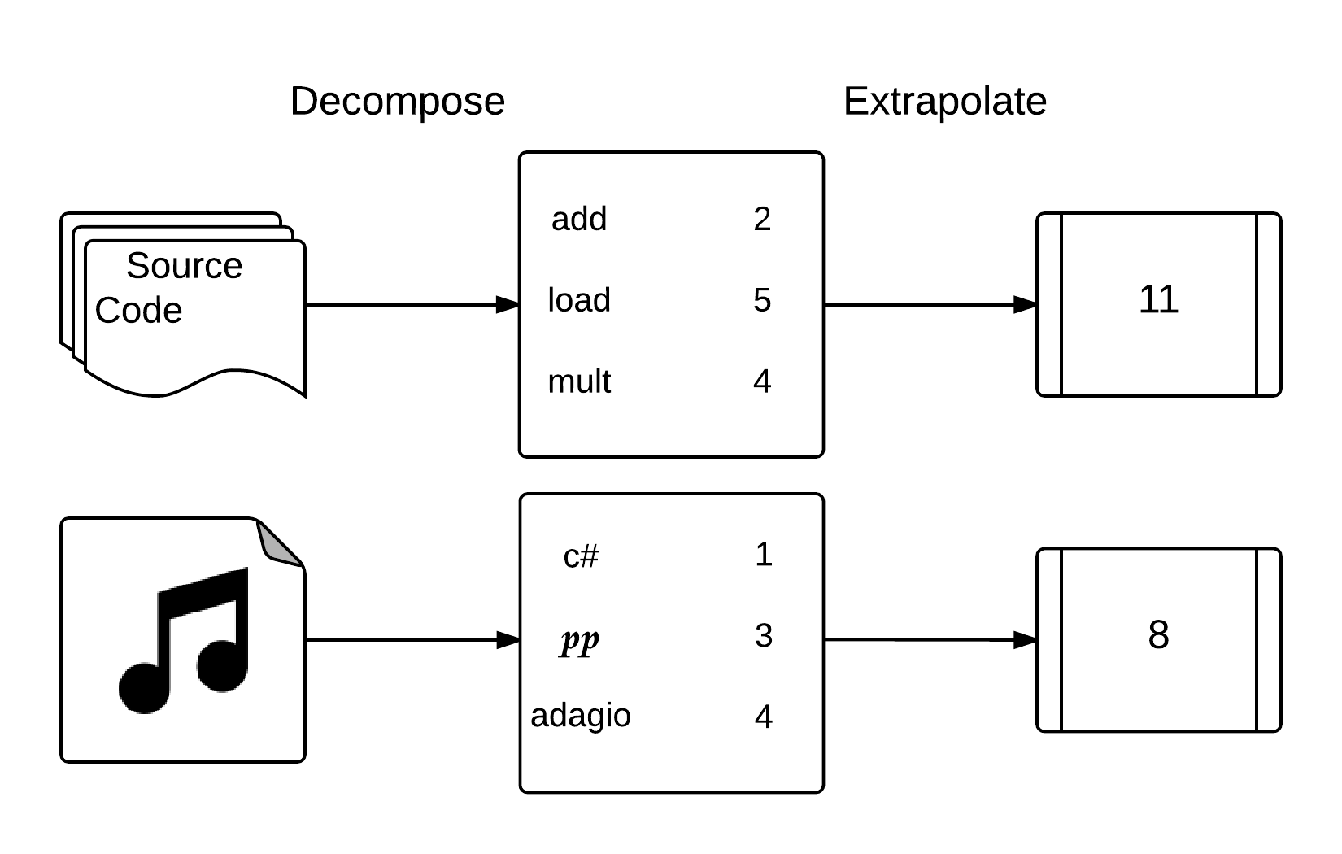
Approach
Decompose a piece into its musical elements and extrapolate complexity measurements from supplied weights (individual complexity parameters).
Notes:
Computation thinking
Program performance estimation analogies.

Slide 10
Approach
Complexity parameters
“What” (i.e., is being played)
Individual notes
Intervals
“How” (i.e., how “what” components are played)
Key signature
Dynamics
Tempo/Duration
Articulation: Slurred/Separated (i.e., legato/staccato)

Slide 11
Approach
Rank each of the predefined complexity parameters.
Use default values for unranked parameters.
The “what” components get specific values.
The “how” parameters become multipliers for “what” components.

Slide 12
Approach
Leverage outside experts to determine complexity parameters for individual musical elements on each instrument.
Qualtrics Survey
Awaiting IRB Approval
Use our own parameters until we have conclusive new ones.
Notes:
So far abstract

Slide 13
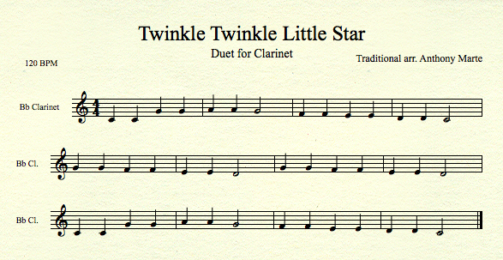
Example

Slide 14
Example
Notes
C4 C4 G4 G4 A4 A4 G4 F4 F4 E4 E4 D4 D4 C4
G4 G4 F4 F4 E4 E4 D4 G4 G4 F4 F4 E4 E4 D4
C4 C4 G4 G4 A4 A4 G4 F4 F4 E4 E4 D4 D4 C4

Slide 15
Example
Note Weights
1 1 1 1 2 2 1 1 1 1 1 1 1 1
1 1 1 1 1 1 1 1 1 1 1 1 1 1
1 1 1 1 2 2 1 1 1 1 1 1 1 1

Slide 16
Example
Note Weights with Articulations Multiplier
1 1 1 1 2 2 1 1 1 1 1 1 1 1
1 1 1 1 1 1 1 1 1 1 1 1 1 1
1 1 1 1 2 2 1 1 1 1 1 1 1 1
Notes:
No articulations so multiplied by 1

Slide 17
Example
Note Weights with Articulations and Dynamics Multipliers
1.5 1.5 1.5 1.5 3 3 1.5 1.5 1.5 1.5 1.5 1.5 1.5 1.5
1.5 1.5 1.5 1.5 1.5 1.5 1.5 1.5 1.5 1.5 1.5 1.5 1.5 1.5
1.5 1.5 1.5 1.5 3 3 1.5 1.5 1.5 1.5 1.5 1.5 1.5 1.5
Notes:
No dynamics so multiplied by 1.5 default

Slide 18
Example
Note Weights with Articulations, Dynamics, and Key Signature Multipliers
1.5 1.5 1.5 1.5 3 3 1.5 1.5 1.5 1.5 1.5 1.5 1.5 1.5
1.5 1.5 1.5 1.5 1.5 1.5 1.5 1.5 1.5 1.5 1.5 1.5 1.5 1.5
1.5 1.5 1.5 1.5 3 3 1.5 1.5 1.5 1.5 1.5 1.5 1.5 1.5
= 24
= 21
= 24
________
69
Notes:
Key of C so multiplier is 1

Slide 19
Example
Intervals
1 5 1 2 1 2 2 1 2 1 2 1 2
5 1 2 1 2 1 2 4 1 2 1 2 1 2
2 1 5 1 2 1 2 2 1 2 1 2 1 2

Slide 20
Example
Interval Weights
1 5 1 8 1 8 2 1 2 1 2 1 2
5 1 2 1 2 1 2 4 1 2 1 2 1 2
2 1 5 1 8 1 8 2 1 2 1 2 1 2

Slide 21
Example
Interval Weights with Articulations Multiplier
1 5 1 8 1 8 2 1 2 1 2 1 2
5 1 2 1 2 1 2 4 1 2 1 2 1 2
2 1 5 1 8 1 8 2 1 2 1 2 1 2

Slide 22
Example
Interval Weights with Articulations and Dynamics Multipliers
1.5 7.5 1.5 12 1.5 12 3 1.5 3 1.5 3 1.5 3
7.5 1.5 3 1.5 3 1.5 3 6 1.5 3 1.5 3 1.5 3
3 1.5 7.5 1.5 12 1.5 12 3 1.5 3 1.5 3 1.5 3

Slide 23
Example
Interval Weights with Articulations, Dynamics, and Key Signature Multipliers
1.5 7.5 1.5 12 1.5 12 3 1.5 3 1.5 3 1.5 3
7.5 1.5 3 1.5 3 1.5 3 6 1.5 3 1.5 3 1.5 3
3 1.5 7.5 1.5 12 1.5 12 3 1.5 3 1.5 3 1.5 3
= 52.5
= 40.5
= 55.5
________
148.5

Slide 24
Example
Note Duration Multiplier (Total Notes / Total Beats) * (Beats Per Minute / Sec Per Min)
1.75 = (42 / 48) * (120 / 60)
Total Notes
42
Total
Beats
48

Slide 25
Example
Note Total
Interval Total
Total Score
= Note Weights * All Multipliers
= Interval Weights * All Multipliers
= Note Total + Interval Total
= 69 * 1.75
= 148.5 * 1.75
= 120.75 + 259.875
= 120.75
= 259.875
= 380.625

Slide 26
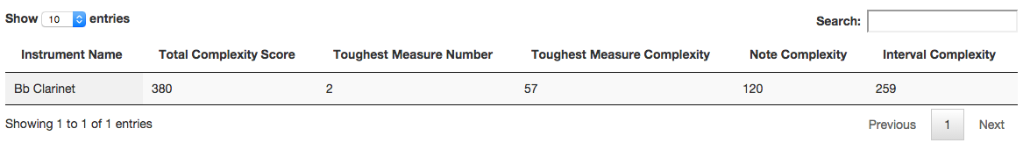
Example
Note Total
Interval Total
Total Score
= Note Weights * All Multipliers
= Interval Weights * All Multipliers
= Note Total + Interval Total
= 69 * 1.75
= 148.5 * 1.75
= 120.75 + 259.875
= 120.75
= 259.875
= 380.625
Notes:
Website matches
How does the website work?

Slide 27
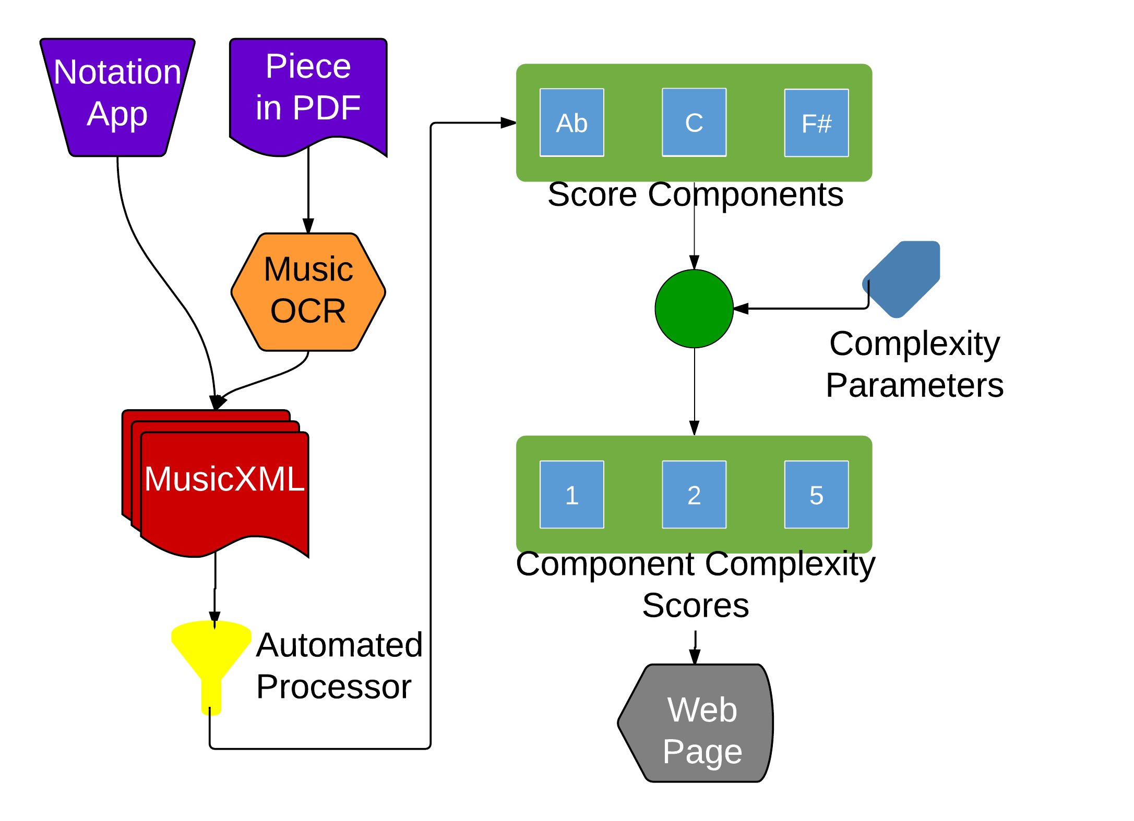
Proof of Concept
Accepts MusicXML files as input (via notation software or OCR conversion).
Tokenizes important musical elements for scoring (notes, intervals, dynamics, articulations, durations, and key signatures).
Weights tokens based on specified complexity parameters.
Aggregates and visualizes score data for consumption.
Notes:
Flow diagram of exactly what happens

Slide 28
Proof of Concept
Implemented as a two-tier Web-based architecture:
Frontend (HTML, Javascript, CSS) (~1K of SLOC)
Backend (Java, PHP) (~10K of SLOC)
Deployed on a Unix server (Mac Mini):
OS X Mavericks (Version 10.9.1)
Apache Server(Version 2.2.24)
Optimized for distributed usability and scalability:
Leverages open-source libraries for backend parsing
Employs Javascript UI frameworks for aesthetic appeal
JQuery, Bootstrap, D3, DataTables, VexFlow
Utilizes JSON format for quick response time
Notes:
Nuts and bolts

Slide 29
Proof of Concept
Implementation Highlights
Extensible software architecture via heavy use of the Visitor Design Pattern
Amenable to future model refinements
Modular pipeline structure to afford the integration of new components
Accessible for mobile clients, albeit with adapted client-side interface
Scalable elastically to accommodate dissimilar usage scenarios

Slide 30

Proof of Concept
Cloud interface for generating complexity scores.
http://mickey.cs.vt.edu/
https://github.com/xwsxethan/MusicScoring

Slide 31
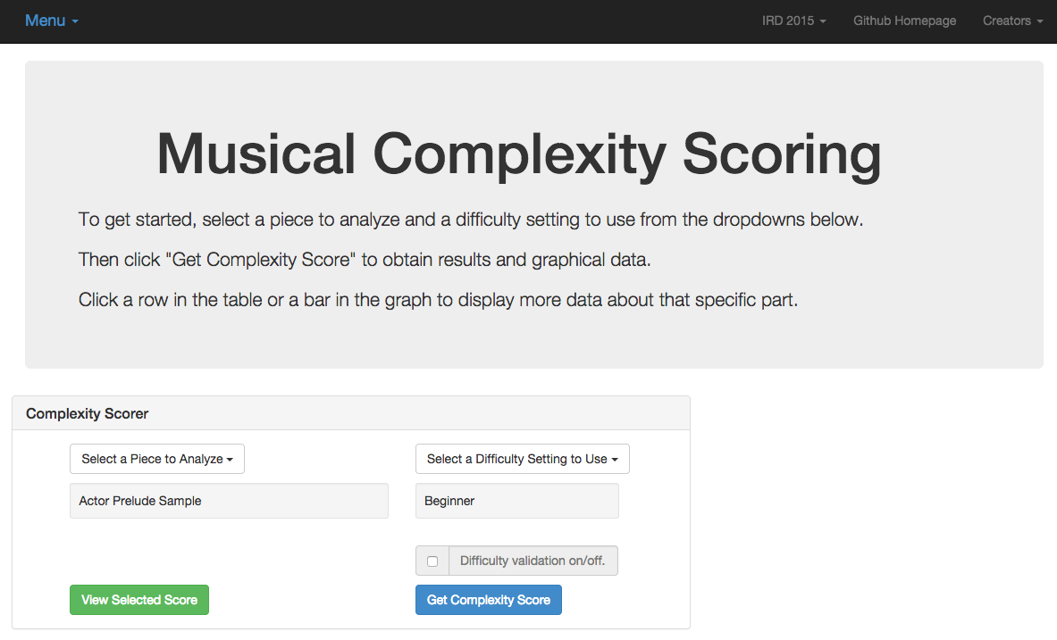
Proof of Concept

Slide 32
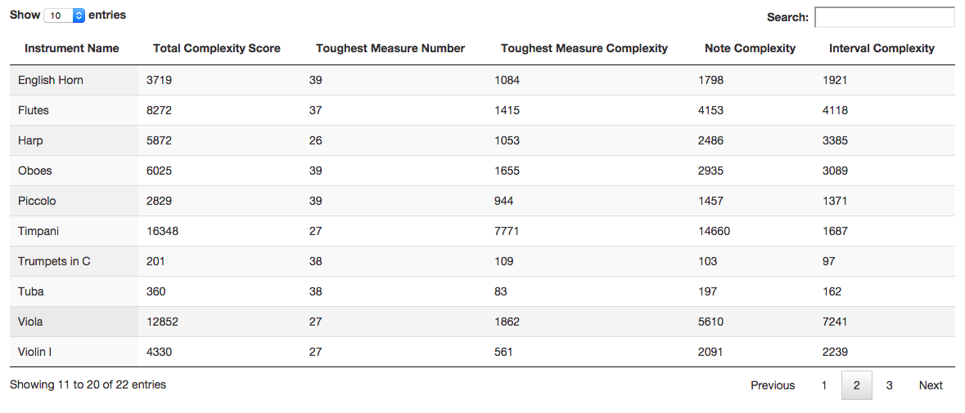
Proof of Concept

Slide 33
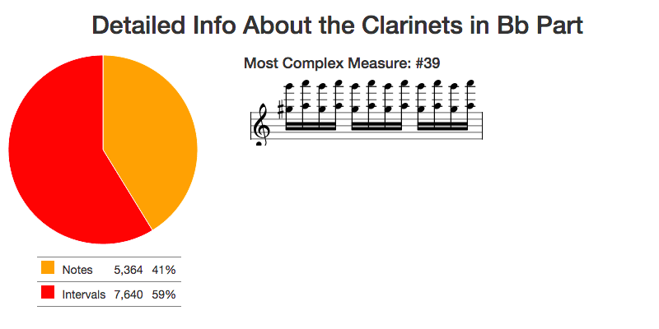
Proof of Concept

Slide 34
Musiplectics in Action
Experiment Setup:
Find manually scored pieces of music for Bb Clarinet from an outside source (Royal Conservatory syllabus).
Convert these manually scored pieces into MusicXML (music OCR software).
Generate complexity scores for these pieces with our system.
Compare our complexity scores to the manual scores.

Slide 35
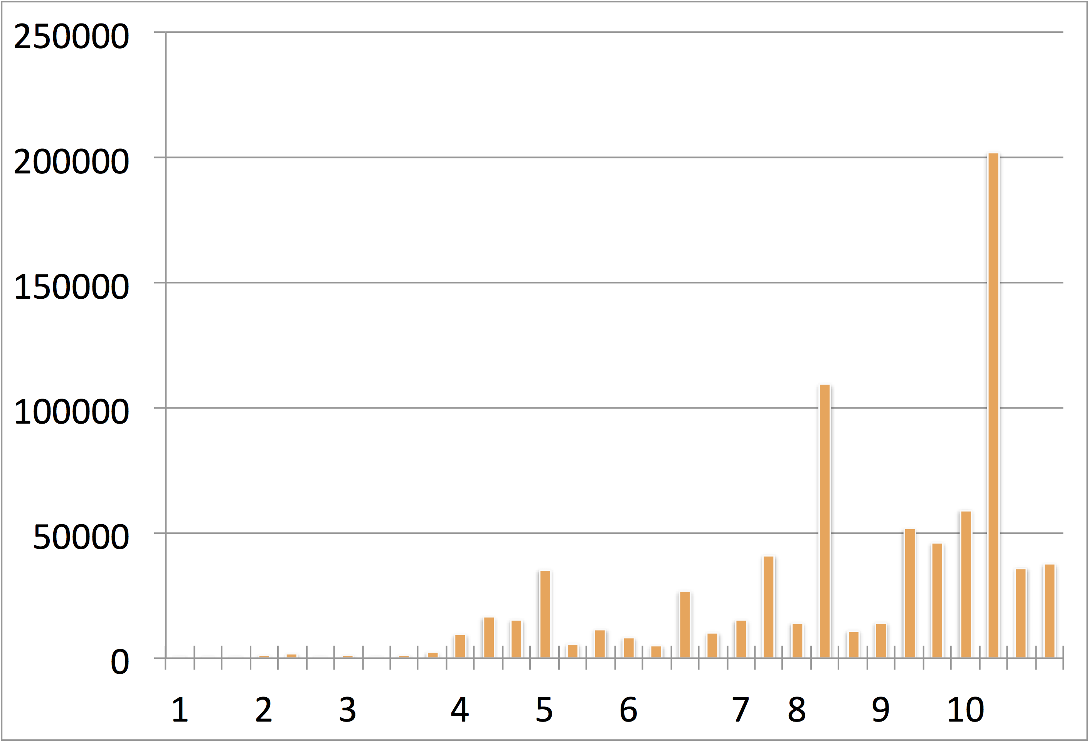
Musiplectics in Action
Complexity
Scores
Curricular Recommendations (Royal Conservatory)

Slide 36
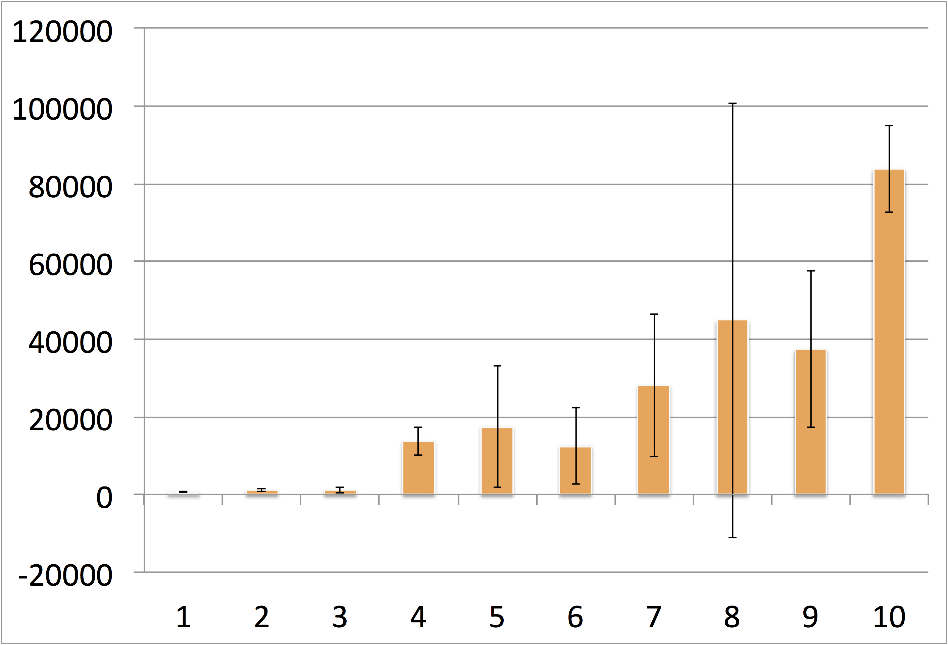
Musiplectics in Action
Average
Complexity
Scores
Curricular Recommendations (Royal Conservatory)

Slide 37
Future Work
Expanding instrument complexity parameters.
Presenting at ICAT day in the Moss Arts Center.
Leveraging other research to expand the tool chain.
Music OCR, MIDI conversion
Surveying experts for baseline complexity parameters.
Integrating with existing music libraries.
IMSLP.org, National Library
Adding reference pieces to relate complexity scores to well known works.
Measuring physiological signals to determine mental complexity.

Slide 38
Thesis Contributions
Our initial complexity scores show Musiplectics’ promise as viable approach to automate complexity assessment.
Largely agree with subjective grades (Royal Conservatory instructional syllabus) of publicly available music pieces for B♭ Clarinet.
Musiplectics can automate a meticulous, manual process, providing consistent results on a ubiquitous platform.
The preliminary results have been submitted to ONWARD’15 for publication.

Slide 39
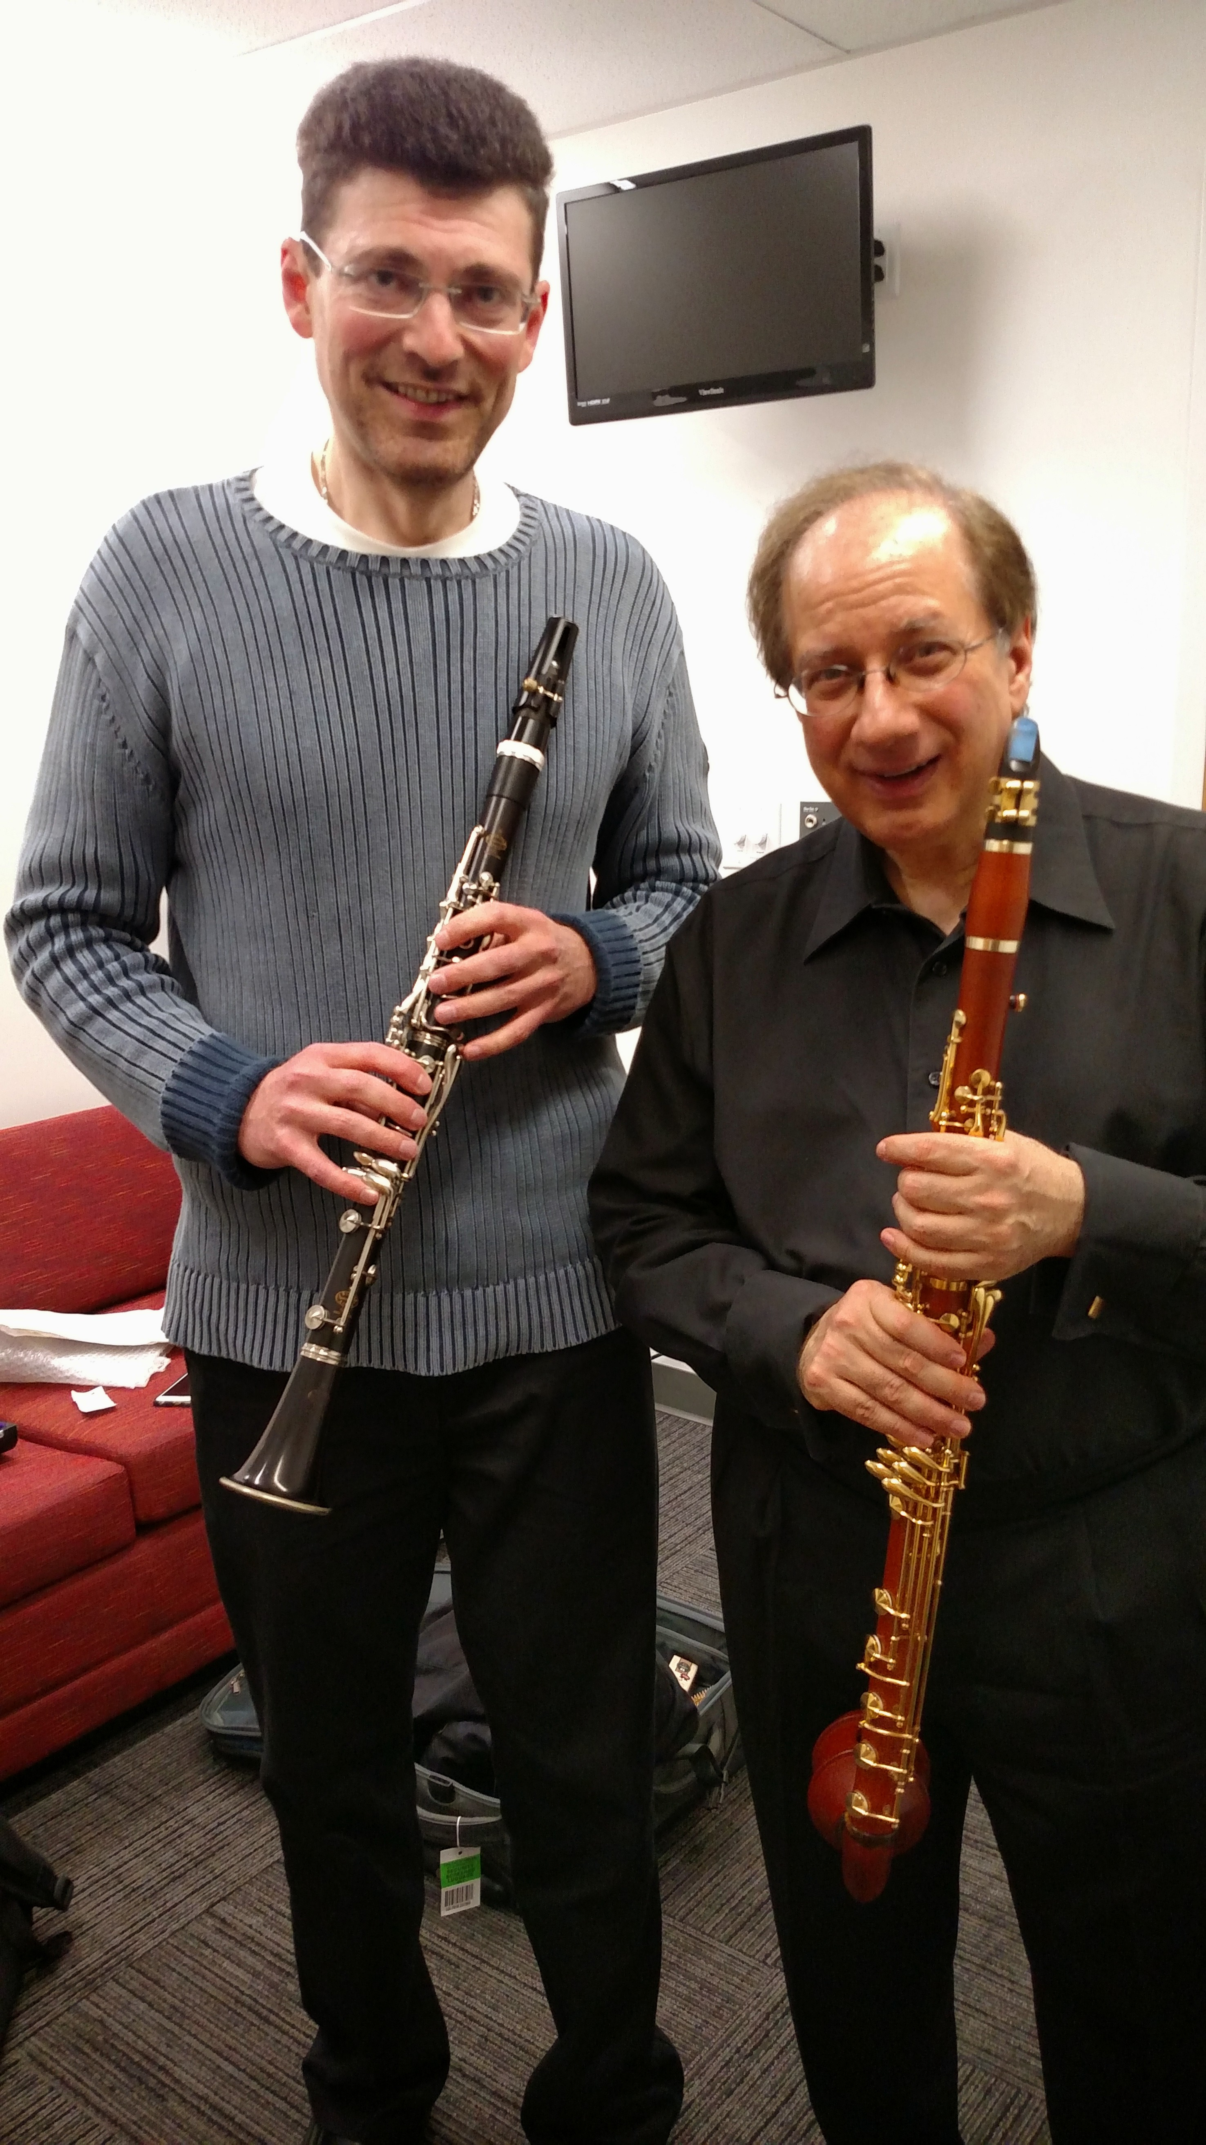
Endorsement from Charles Neidich
Acclaimed Concert Clarinetist
Silver Medal (1979 Geneva Competition)
Second Prize (1982 Munich Competition)
Grand Prize (1984 Accanthes Competition)
First Prize (1985 Walter M. Naumberg Competition)
Faculty at Julliard and Manhattan School of Music
“I find your approach very interesting with high potential practical benefit, particularly for music educators.”
“To achieve maximum benefit, your complexity interface must effortlessly drill down to any level of detail.”

Slide 40
Summary and Questions
Note difficulty disparity insights form the theoretical basis.
Musiplectics decomposes pieces of music and extrapolates complexity data from weighted musical elements.
The proof of concept is publicly available online for anyone to use.
Initial complexity scores show Musiplectics’ promise as viable approach to automate complexity assessment.
Musiplectics can automate a meticulous, manual process, providing consistent results on a ubiquitous platform.
Questions?

Slide 41
Questions
?

Slide 42
Images
http://www.goodfuneralguide.co.uk/wordpress/wp-content/uploads/2013/04/two-cartoon-men-yelling.jpg
http://www.zsgenetics.com/wp-content/uploads/2013/01/dna-split-504x482.png
https://s-media-cache-ak0.pinimg.com/originals/49/0a/eb/490aeb9159c5b3044035cfbf7e4a19f3.jpg

Slide 43
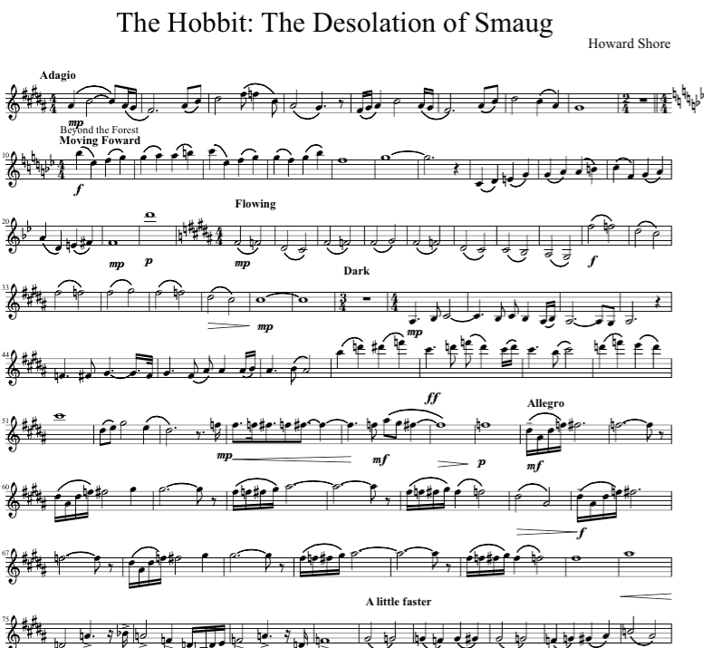
User Questions and Needs
How difficult is this piece of music?
What makes this piece of music more or less difficult than others?
What portion of this piece is the most difficult?
Why?

Slide 44
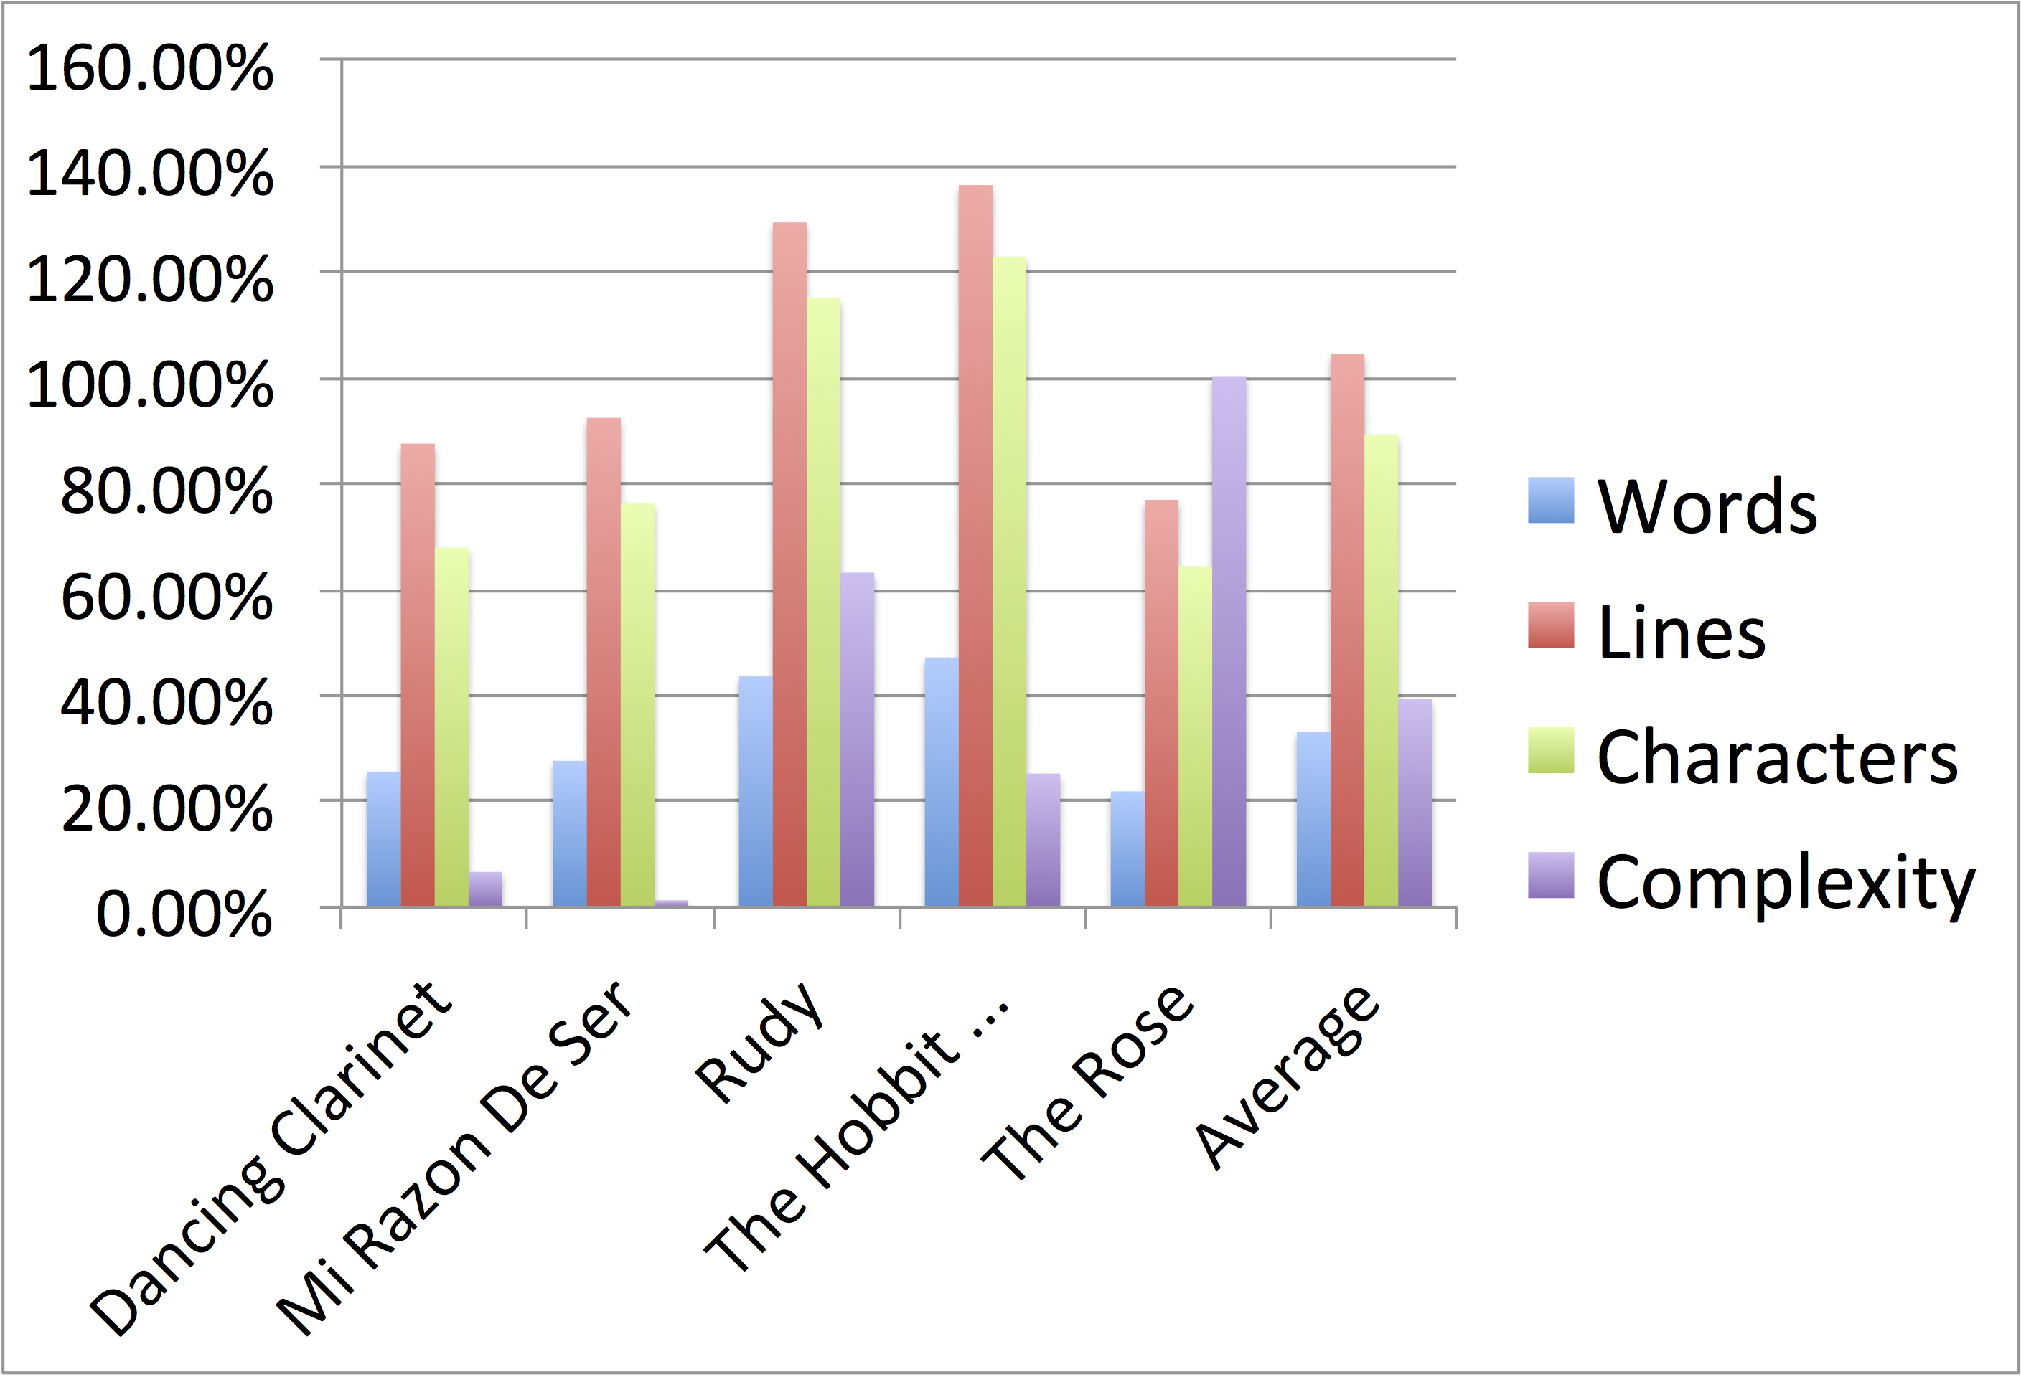
Reliability of Music OCR
Percentage
Difference
By Category
Music Pieces Converted with Music OCR (MuseScore)

Slide 45
Related Work
Complexity Analysis
Chiu2012 (just for piano) and Heijink2002 (just for guitar)
Liou2010 (L-system for trees on rhythm only)
VBODA and NYSSMA (state organizations manual rankings)
Madsen2006 and Streich2006 (listener complexity)

Slide 46
Related Work
Music Scan and Search
Byrd2001 shows why we need efficient means of searching for music which complexity scores can provide.
Allali2009 demonstrates how we can alter complexity by simplifying polyphonic music down to a monophonic equivalent.

Slide 47
Related Work
Music Classification
Cuthbert2011 shows how to extract features from pieces and apply machine learning to classify the genre of a work.
Cataltepe2007 are able to classify MIDI pieces of music by approximating the Kolmogorov distance with a string representation and matching based on that measurement.

